Slide 1
Adama Science and Technology University
“We are dedicated to innovation knowledge”

Slide 2
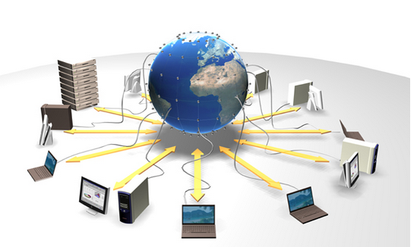
Processes
Chapter 3

Slide 3
Recall of Processes
Communication can be takes place between processes.
A process is a program in/under execution i.e. active program.
    a program that is currently being executed on one of the operating system's virtual processors.
    The process is an instance of program running on a computer
    It is the entity that can be assigned to and executed on a processor.
Multiple processes may be concurrently sharing the same resource (i.e. CPU and other hardware resources) is made transparent.
From OS perspective, management and scheduling of processes is important.

Slide 4
Processes…..
Virtual processors
    Created by OS to execute or running a different program
    The OS has Process table to keep track of virtual processors
      containing entries to store CPU register values, memory maps, open files, accounting information, privileges, etc.
OSs ensure that processes are independent and transparent
    Do not affect each other’s correctness
    Resource sharing is transparent

Slide 5
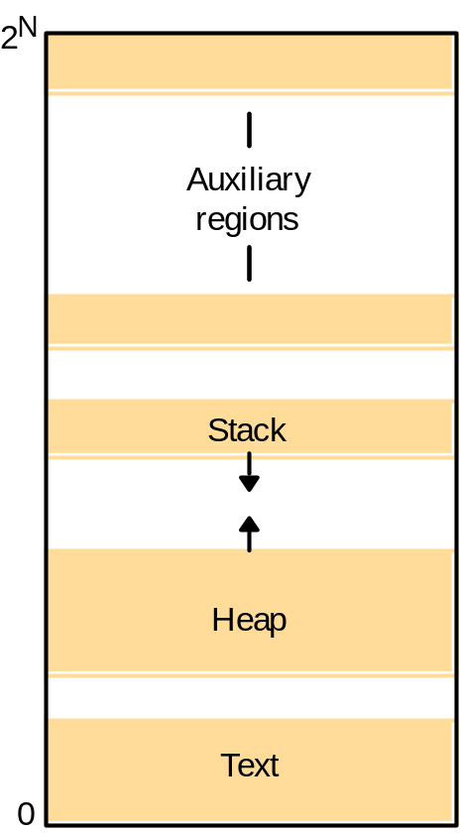
Processes…..
A process includes:
    program counter
    code segment
    stack segment
    data segment
Process = Address Space
+ Single thread of control
Address space

Slide 6
Costs of Processes
Processes are costly b/c creating a process requires creation of an entire
  new address space, initializing memory segment, copying instructions to text segment, initializing stack
Switching between processes is costly as well
    Saving CPU context, modify registers of the memory management unit, swapping processes (if number of processors are larger than what can fit in main memory)

Slide 7
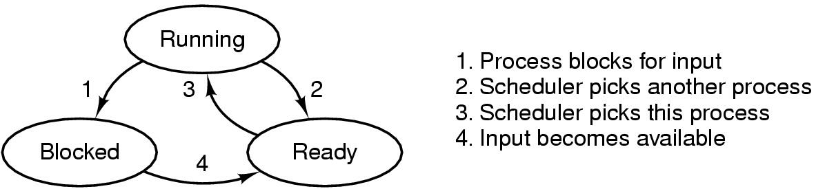
Process States
Possible process states
    running
    blocked
    ready
Transitions between states shown

Slide 8
Context Switch
Inter-process communication is expensive: need context switching
    When the CPU switching from one process to the other is known as context switching.
When CPU switches to another process, the system must save the state of the old process and load the saved state for the new process.
Context-switch time is overhead;
    the system does no useful work while switching.
    Time dependent on hardware support.

Slide 9
Cooperating processes
Cooperating processes need to share information (data). Since each process has its own address space, operating system mechanisms are needed to let processes exchange information.
Two paradigms for cooperating processes.
  Shared Memory
      OS enables two independent processes to have a shared memory segment in their address spaces.
  Message-passing
      OS provides mechanisms for processes to send and receive messages.

Slide 10
Threads and their Implementation

Slide 11
Introduction
How are processes and threads related?
Process tables(PCBs) are used to keep track of processes
There are usually many processes executing concurrently
  processes should not interfere with each other;
  sharing resources by processes is transparent
This concurrency transparency has a high price; allocating resources for a new process and context switching take time.
A thread also executes independently from other threads; but no need of a high degree of concurrency transparency thereby resulting in better performance.

Slide 12
Threads
A thread is a single sequence stream within in a process.
    because threads have some of the properties of processes, they are sometimes called lightweight processes.
It is an execution of part of process on virtual processor.
In a process, threads allow multiple executions of streams.
A thread of execution is
    the smallest sequence of programmed instructions that can be managed independently by a schedular which is typically a part of the OS.
Very little overheads (thread switching is easy (it use process memory)
Can provide performance gains

Slide 13
Thread Structure….
Process is used to group resources together and
    threads are the entities scheduled for execution on the CPU.
The thread has a program counter that keeps track of which instruction to execute next.
    It has registers, which holds its current working variables.
    It has a stack, which contains the execution history.
Although a thread must execute in some process,
        the thread and its process are different concepts and
        can be treated separately.

Slide 14
Thread Structure….
Process is unit of allocation
    E.g. resource, privileges etc.
Thread is unit of execution
      e.g. PC, Stack pointer, register etc.
Note
  Each threads belongs to only one process and
  Each process has one or more threads

Slide 15
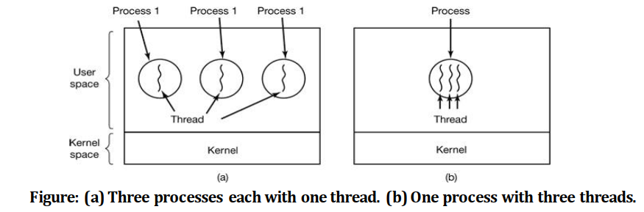
Thread Structure….
What threads add to the process model?
    It allow multiple executions to take place in the same process environment, to a large degree independent of one another.
    This called Multithread (to enhance performance)
Having multiple threads running in parallel in one process is similar to having multiple processes running in parallel in one computer.

Slide 16
Thread Structure….
A process has an address space (containing program text and data) and a single thread of control, as well as other resources such as open files, child processes, accounting information, etc.
Each thread has its own program counter, registers, stack, and state;
    but all threads of a process share address space, global variables and other resources such as open files, etc.

Slide 17
Difference between Process and Thread
Comparison Basis | Process | Thread
Definition | A process is a program under execution i.e. an active program. | A thread is a lightweight process that can be managed independently by a scheduler
Context switching time | Processes require more time for context switching as they are heavier. | Threads require less time for context switching as they are lighter than processes.
Memory Sharing | Processes are totally independent and don’t share memory. | A thread may share some memory with its peer threads.
Communication | Communication between processes requires more time than between threads. | Communication between threads requires less time than between processes.
Blocked | If a process gets blocked, remaining processes can continue execution. | If a user level thread gets blocked, all of its peer threads also get blocked.
Resource Consumption | Processes require more resources than threads. | Threads generally need less resources than processes.
Dependency | Individual processes are independent of each other. | Threads are parts of a process and so are dependent.
Data and Code sharing | Processes have independent data and code segments. | A thread shares the data segment, code segment, files etc. with its peer threads.
Treatment by OS | All the different processes are treated separately by the operating system. | All user level peer threads are treated as a single task by the operating system.
Time for creation | Processes require more time for creation. | Threads require less time for creation.
Time for termination | Processes require more time for termination. | Threads require less time for termination.

Slide 18
Cont.…
Similarities between Process and Thread
  Like processes threads share CPU and only one thread is running at a time.
  Like processes thread can create children.
  Like a traditional process, a thread can be in any one of several states: running, blocked, ready or terminated.
      Running thread currently has the CPU and it active
      Blocked is waiting for other thread to unblock it
      Ready is scheduled to run and
      Terminated thread is one that has exited

Slide 19
Cont.…
Similarities between Process and Thread
  Like process threads have Program Counter, Stack, Registers and State.
  Threads can be terminated in one of two ways:
        Exit voluntary when it’s finish its job or it can be killed from outside.
Threads can be used in both
        distributed and non distributed systems

Slide 20
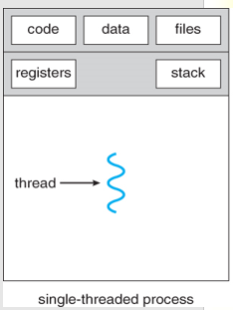
Thread Usage in Non-distributed Systems
Single threaded process
  Whenever a blocking system call is executed- the whole process is blocked.
  Would be able to service only one client at a time.
  Run with two threads- Microsoft Excel Spreadsheet
    One handling interaction with the user
    One for updating the spreadsheet

Slide 21
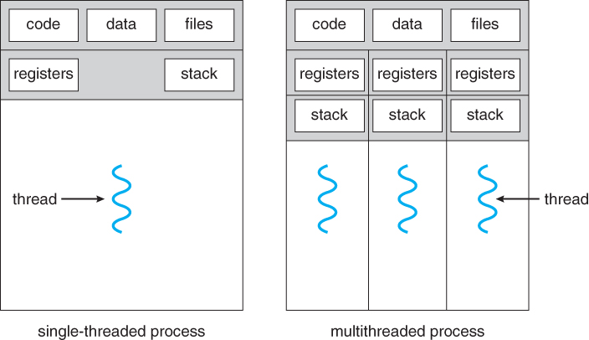
Thread Usage in Non-distributed Systems
Multithreads Process
Exploit parallelism in the case of multiprocessor system.
  Shared data is stored in shared memory.
  Each CPU run different thread.
Also useful in large application
  Collection of cooperating programs, each to be executed by a separate process.
  IPC in UNIX system

Slide 22
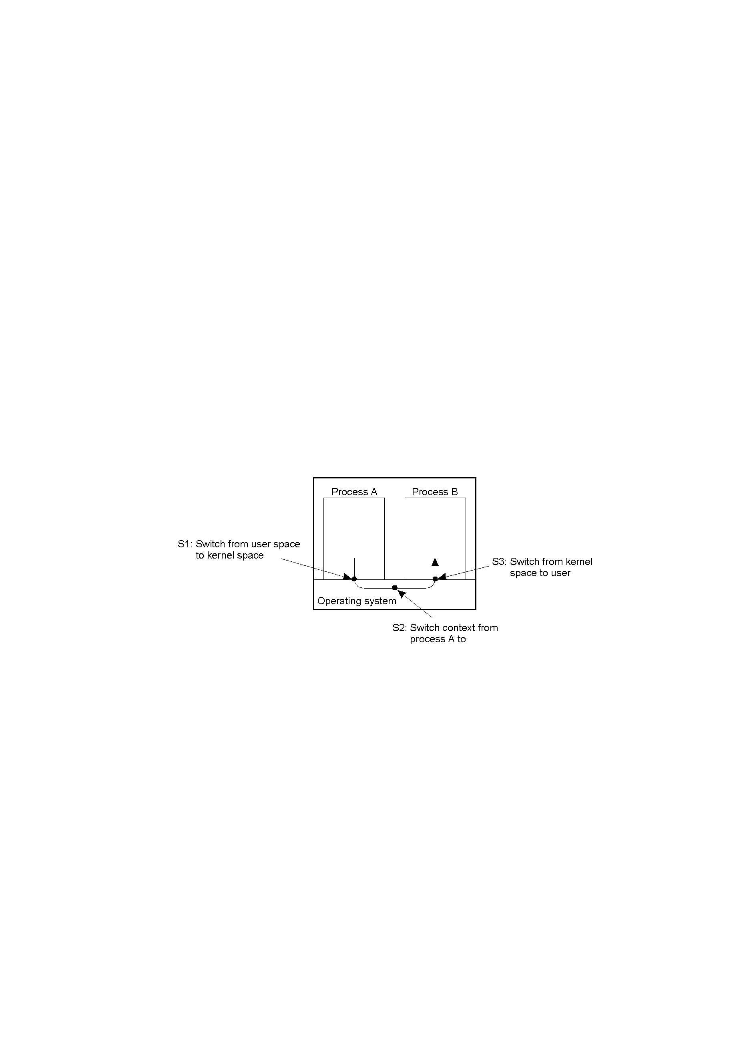
Cont.….
In non distributed systems,
  threads can be used with shared data instead of processes to avoid context switching overhead inter process.
Context switching as the result of IPC

Slide 23
Cont.…
Drawbacks IPCs:- Communication between two process requires extensive context switching ➔ kernel mode <-> user mode
    Needs kernel intervention (due to separate address spaces)
    Multiple context switches
    Context switches are costly (expensive)

Slide 24
Cont.…
Thread Usage –Why do we need threads?
e.g., a word processor has different parts for
  interacting with the user
  formatting the page as soon as changes are made
  timed savings (for auto recovery)
  spelling and grammar checking, etc.
Simplifying programming model since many activities are going on at once more or less independently
Easier to create and destroy than processes since they do not have any resources attached to them
Performance improves by overlapping activities if there is too much I/ O; i. e., to avoid blocking when waiting for input or doing calculations, say in a spreadsheet
Invented to allow parallelism is possible in a multiprocessor system

Slide 25
Thread Implementation
Threads are generally provided (implemented) in the form of a thread package.
  the package contains operations to create and destroy a thread, operations on synchronization variables such as mutexes and condition variables between them.
There are two main approaches of implement a threads package;
  Construct a thread library that is executed entirely in user mode (the OS is not aware of threads)
  Implement them in the OS’s kernel

Slide 26
Thread Implementation….
User-level threads (User Managed)
  Implemented by thread library & kernel knows nothing about them
  Programmer of thread library write it’s code to synchronize threads and context switch them.
  Thread creation, destruction and context switching are cheap.
  Switching threads context can be done with a few instruction-synchronizing when entering a section of shared data.
      Only the value of CPU register need to be changed
      No need to change memory map

Slide 27
Thread Implementation….
Drawback is how blocking system calls are implemented.
  the invocation of blocking system call will block the entire process belonging to the threads.
Kernel-Level Threads(OS Managed Threads)
  Let the kernel be aware of threads and schedule them
  Expensive for thread operations such as creation and deletion since each requires a system call.
  Solution: use a hybrid form of user-level and kernel-level threads, called lightweight process (LWP)

Slide 28
Difference b/n User level threads and Kernel level threads
User Level Thread | Kernel Level Thread
User thread are implemented by users. | Kernel threads are implemented by OS.
OS doesn’t recognized user level threads. | Kernel threads are recognized by OS.
Implementation of User threads is easy. | Implementation of Kernel thread is complex.
Context switch time is less. | Context switch time is more.
Context switch requires no hardware support. | Context switch requires hardware support.
If one user level thread performs blocking operation, then entire process will be blocked. | If one kernel thread performs blocking operation, then another thread within the same process can continue execution.

Slide 29
Combining kernel-level and user-level threads
This known as light weight process.
There can be several light weight process (LWP) per process
        run on kernel space

Slide 30
Lightweight Process (LWP)
A hybrid approach
      Lightweight process runs in context of single process.
Reside in kernel
System also offers user-level threads
      All operations occur in user mode
      run on user space
      Creating and destroying thread
Thread package can be shared by multiple LWPs
LWP is created by kernel and given its own stack

Slide 31
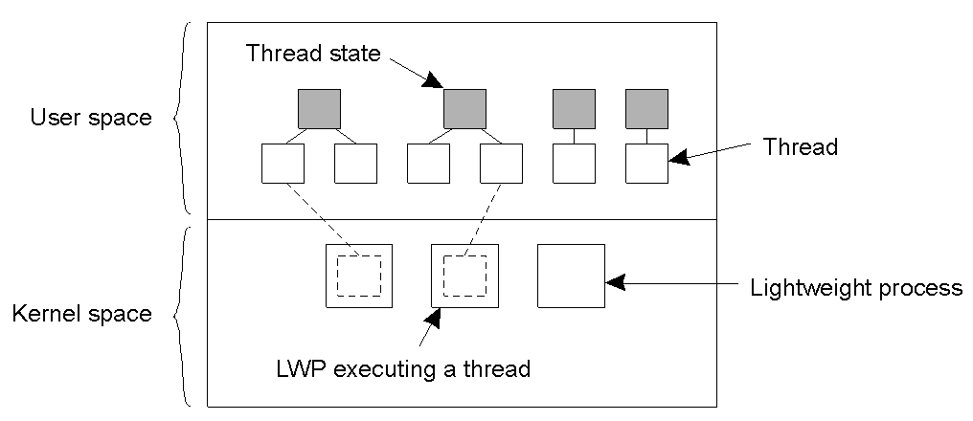
Light-Weight Process
Thread table : keep track of the current set of threads – shared by LWP
Several advantages
  Cheap, will not block entire process, extends to multiprocessing environment

Slide 32
Threads in Distributed Systems
Multithreaded Clients
  Consider a Web browser; fetching different parts of a page can be implemented as a separate thread,
    each opening its own TCP connection to the server
    each can display the results as it gets its part of the page
  Parallelism can also be achieved for replicated servers
    since each thread request can be forwarded to separate replicas

Slide 33
Cont.…
Multithreaded Servers: Servers can be constructed in three ways
  Single-threaded process:- it gets a request, examines it, carries it out to completion before getting the next request. Performance loss due to single threading.
  Threads: threads are more important for implementing servers
      e.g., a file server, the dispatcher thread reads incoming requests for a file operation from clients and passes it to an idle worker thread
  Finite-state machine
      Achieve high performance through Parallelism
      If threads are not available, it gets a request, examines it, tries to fulfill the request from cache, else sends a request to the file system

Slide 34
Cont.…
Model | Characteristics
Single-threaded server | No parallelism, easy of blocking system calls (give up performance)
Threads | Parallelism, blocking system calls (thread only)
Finite-state machine | Parallelism, non blocking system calls

Slide 35
Cont.….
Anatomy of Clients
Two issues: User interfaces and client-side software for distribution transparency
User Interfaces
  To create a convenient environment for the interaction of a human user and a remote server; e.g. mobile phones with simple displays and a set of keys
  GUIs are most commonly used
  The X Window System (X Sample ) as an example
  it has the X kernel: the part of the OS that controls the terminal (monitor, keyboard, pointing device like a mouse) and is hardware dependent.

Slide 36
Cont.….
Client-Side Software for Distribution Transparency
  In addition to the user interface, parts of the processing and data level in a client-server application are executed at the client side.
    an example is embedded client software for ATMs, cash registers, etc.
    Moreover, client software can also include components to achieve distribution transparency
        e.g., replication transparency
    Assume a distributed system with replicated servers; the client proxy can send requests to each replica.

Slide 37
Servers and Design Issues
Issues
    how to organize servers?
    where do clients contact a server?
    whether and how a server can be interrupted
    whether or not the server is stateless
1. How to organize servers?
Servers is organized in several ways:-
Iterative server
    The server itself handles the request and
    Return the response to the requesting client

Slide 38
Servers and Design Issues…
Concurrent server
    Pass the request to separate thread/process (not handle by itself)
    Wait for next incoming request
    Example of multithreaded server.

Slide 39
Servers and Design Issues
2. Where do clients contact a server?
Using endpoints or ports at the machine where the server is running where each server listens to a specific endpoint.
How do clients know the endpoint of a service?
  Globally assign endpoints for well-known services; e.g. FTP is on TCP port 21, HTTP is on TCP port 80
  for services that do not require preassigned endpoints, it can be dynamically assigned by the local OS

Slide 40
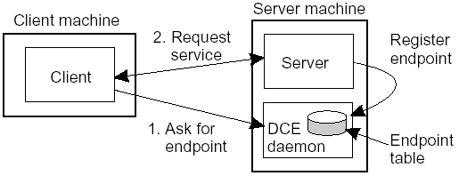
Servers and Design Issues…
How can the client know this endpoint? two approaches
    have a daemon running and listening to a well-known endpoint like in DCE; it keeps track of all endpoints of services on the collocated server
      the client will first contact the daemon which provides it with the endpoint, and then the client contacts the specific server.
Client-to-server binding using a daemon as in DCE

Slide 41
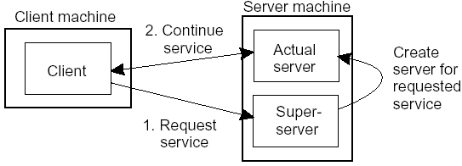
Servers and Design Issues…
Use a super server (as in UNIX) that listens to all endpoints and then forks a process to take care of the request;
        this is instead of having a lot of servers running simultaneously and most of them idle
Client-to-Server binding using a superserver as in UNIX

Slide 42
Servers and Design Issues…
3. Whether and how a server can be interrupted
  for instance, a user may want to interrupt a file transfer, may be it was the wrong file
  let the client exit the client application; this will break the connection to the server; the server will tear down the connection assuming that the client had crashed or
  let the client send out-of-bound data, data to be processed by the server before any other data from the client; the server may listen on a separate control endpoint; or send it on the same connection as urgent data as is in TCP
  Note: we require OS supports high-priority scheduling of specific threads or processes.

Slide 43
Servers and Design Issues…
  4. whether or not the server is stateless
    a stateless server does not keep information on the state of its clients; for instance a Web server
    a stateful server maintains information about its clients;
        for instance a file server that allows a client to keep a local copy of a file and can make update operations

Slide 44
Code Migration
So far, communication was concerned on passing data.
We may pass programs, even while running and in heterogeneous systems
In DS entire process was moved from one machine to another
Code migration also involves moving data as well: when a program migrates while running, its status, pending signals, and other environment variables such as the stack and the program counter also have to be moved.
Moving a running process is costly in term of performance.
  So, Ship(move) part of the client application to the server and send only the result across the network
        Improve performance and more flexible.

Slide 45
Reasons for Migrating Code
To improve computing performance; move processes from heavily-loaded to lightly-loaded machines (load balancing)
To improve communication time: move a client application that performs many database operations to a server if the database resides on the server; then send only results to the client
To exploit parallelism (for non-parallel programs): e.g., copies of a mobile program (called a mobile agent is called in search engines) moving from site to site searching the Web
To have flexibility by dynamically configuring distributed systems: instead of having a multitiered client-server application deciding in advance which parts of a program are to be run where

Slide 46
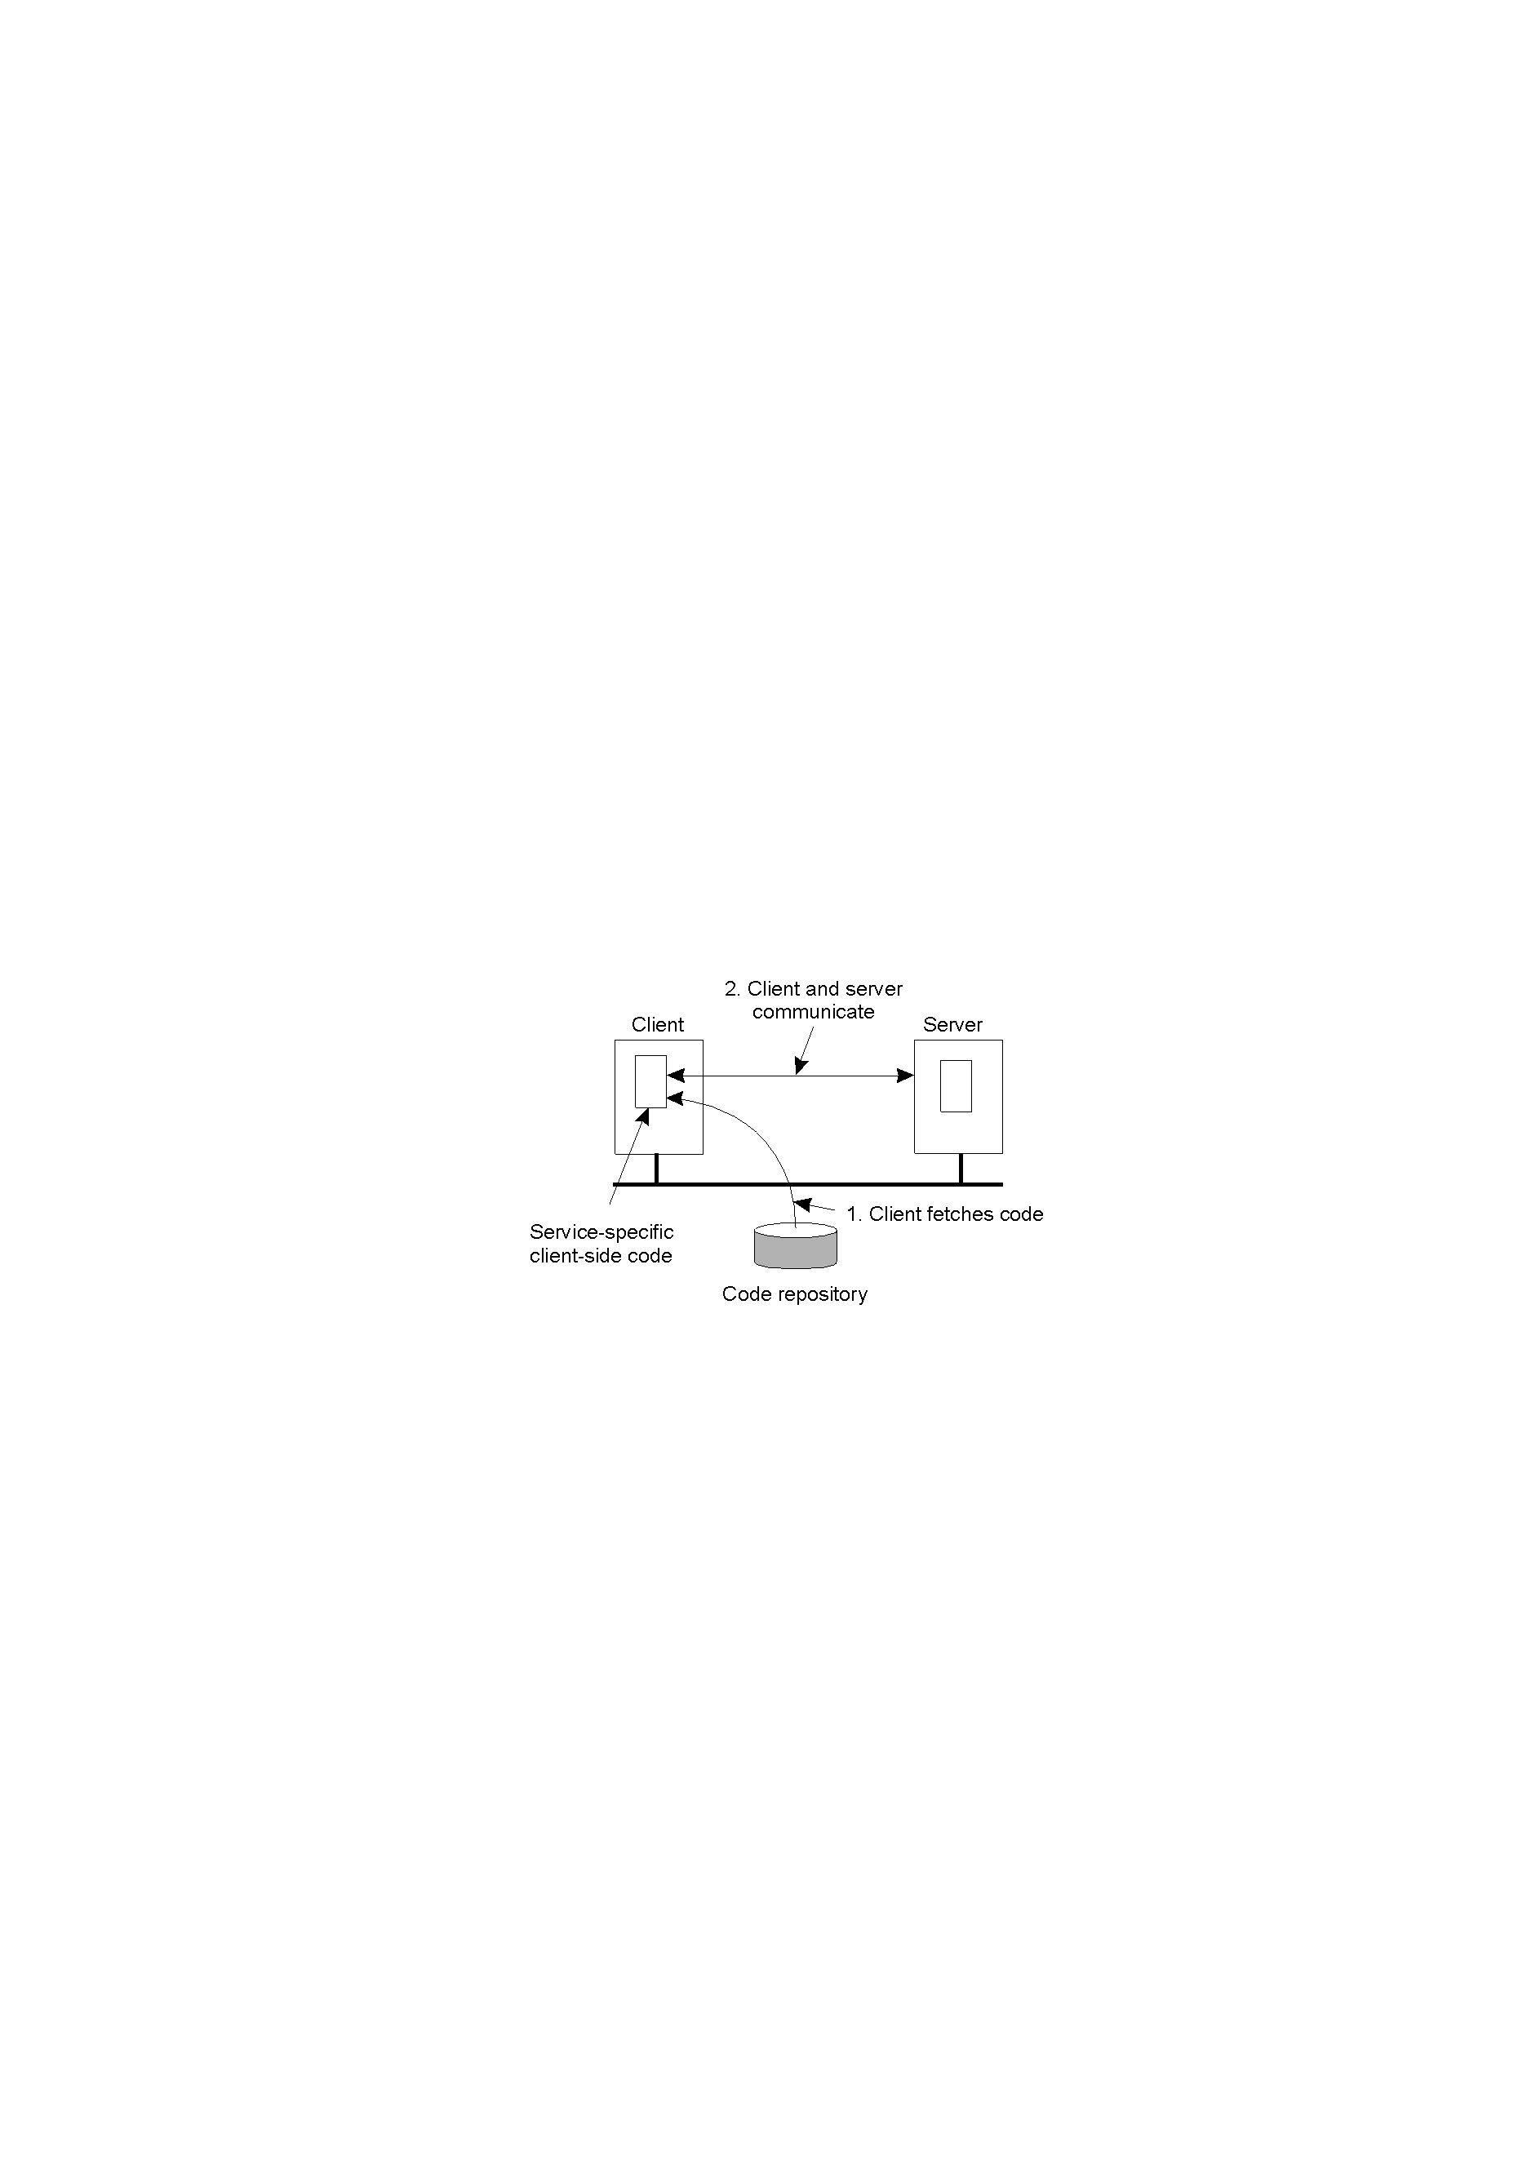
Cont.…
The principle of dynamically configuring a client to communicate to a server,
    The client first fetches the necessary software, and
    then invokes the server.

Slide 47
Models for Code Migration
Process for code migration consists of three segments;
Code Segment
    The part that contains the set of instructions that make up the program that is being executed.
Resource Segment
    Reference to external resource needed by the process i.e.. Printers, files, devices etc.
Execution Segment
    Store current execution state of a process, such as private data, the stack, and the program counter.

Slide 48
Models for Code Migration
Weak Mobility
    transfer only the code segment and may be some initialization data; in this case a program always starts from its initial stage,
        e.g. Java Applets
    execution can be by the target process (in its own address space like in Java Applets) or by a separate process
Strong Mobility
    transfer code and execution segments; helps to migrate a process in execution
    can also be supported by remote cloning; having an exact copy of the original process and running on a different machine; executed in parallel to the original process; UNIX does this by forking a child process.

Slide 49
Models for Code Migration
Migration can be
    Sender-initiated: the machine where the code resides or is currently running;
        e.g., uploading programs to a server; may need authentication or that the client is a registered one
    Receiver-initiated: by the target machine;
        e.g., Java Applets; easier to implement

Slide 50
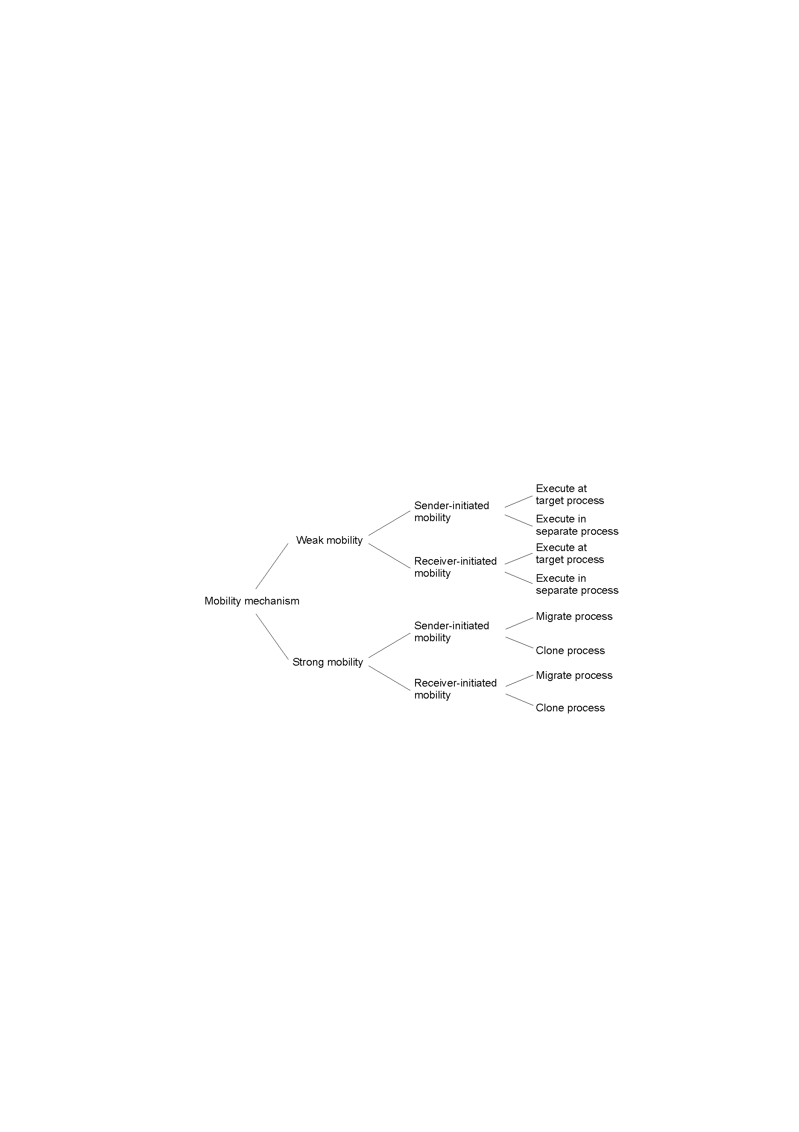
Summary of models of code migration
alternatives for code migration

Slide 51
Migration and Local Resources
How to migrate the resource segment
  not always possible to move a resource; e.g., a reference to TCP port held by a process to communicate with other processes
Types of Process-to-Resource Bindings
  Binding by identifier (the strongest): a resource is referred by its identifier; e.g., a URL to refer to a Web page or an FTP server referred by its Internet address
  Binding by value (weaker): when only the value of a resource is needed; in this case another resource can provide the same value; e.g., standard libraries of programming languages such as C or Java which are normally locally available, but their location in the file system may vary from site to site
  Binding by type (weakest): a process needs a resource of a specific type; reference to local devices, such as monitors, printers, ...

Slide 52
in migrating code, the above bindings cannot change, but the references to resources can
how can a reference be changed? depends whether the resource can be moved along with the code, i.e., resource-to-machine binding
Types of Resource-to-Machine Bindings
  Unattached Resources: can be easily moved with the migrating program (such as data files associated with the program)
  Fastened Resources: such as local databases and complete Web sites; moving or copying may be possible, but very costly
  Fixed Resources: intimately bound to a specific machine or environment such as local devices and cannot be moved
We have nine combinations to consider (next slide)

Slide 53
Resource-to machine binding
 | Unattached | Fastened | Fixed
By identifier By value By type | MV (or GR) CP (or MV, GR) RB (or GR, CP) | GR (or MV) GR (or CP) RB (or GR, CP) | GR GR RB (or GR)
Process-to-resource binding
actions to be taken with respect to the references to local resources when migrating code to another machine
  GR: Establish a global system wide reference
  MV: Move the resource
  CP: Copy the value of the resource
  RB: Rebind process to a locally available resource
Exercise: for each of the nine combinations, give example resources

Slide 54
Migration in Heterogeneous Systems
Distributed systems are constructed on a heterogeneous collection of platforms, each with its own OS and machine architecture
Heterogeneity problems are similar to those of portability
    The target machine may not be suitable to execute the migrated code
    The definition of process/thread/processor context is highly dependent on local hardware, operating system and runtime system
    Solution: Make use of an abstract machine that is implemented
  on different platforms
easier in some languages; for scripting languages the source code is interpreted; for Java an intermediary code is generated by the compiler for a virtual machine

Slide 55
  In weak mobility
    Since there is no runtime information, compile the source code for each potential platform
  In strong mobility
    Difficult to transfer the execution segment since there may be platform-dependent information such as register values;
    One possible solution: restrict migration to specific points in the execution of a program, i.e., only when a subroutine is called
        the runtime system maintains a machine-independent program stack, called migration stack; for this the compiler must generate code to update the migration stack whenever a subroutine is entered or exited

Slide 56
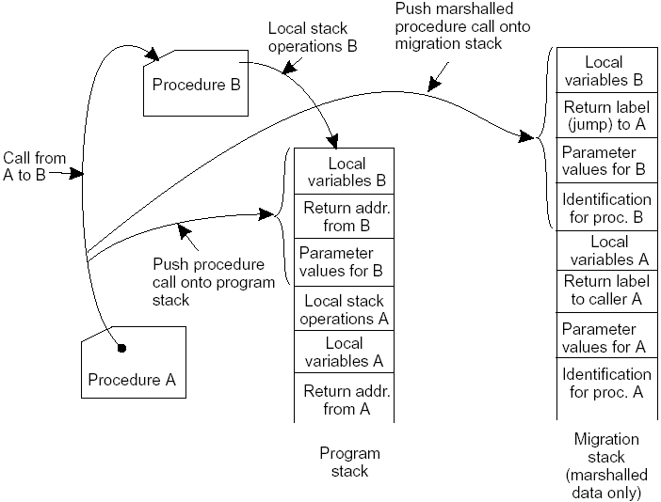
the principle of maintaining a migration stack to support migration of an execution segment in a heterogeneous environment

Slide 57
Software Agents and Agent Technology
  A software agent is an autonomous unit (process) capable of performing a task in collaboration (i.e., it communicates) with other, possibly remote, agents
  It is capable of reacting to, and initiating changes (proactive) in its environment, possibly with users and other agents.
  a collaborative agent is an agent that forms part of a multiagent system, in which agents seek to achieve some common goal through collaboration; e.g., in arranging meetings
  a mobile agent is an agent having the capability to move between different machines; e.g., to retrieve information distributed across a large heterogeneous network such as the Internet.

Slide 58
Software Agents and Agent Technology…
  An interface agent is an agent that assists an end-user in the use of one or more applications and has learning capabilities (it is adaptive); e.g., those that bring buyers and sellers together
  An information agent is an agent that manages information from different sources such as ordering and filtering;
    e.g. an email agent filtering unwanted mail from its owner’s mailbox, or automatically distributing incoming mail into appropriate subject-specific mailboxes.

Slide 59
Software Agents and Agent Technology…
Property | Common to all agents? | Description
Autonomous | Yes | Can act on its own
Reactive | Yes | Responds timely to changes in its environment
Proactive | Yes | Initiates actions that affects its environment
Communicative | Yes | Can exchange information with users and other agents
Continuous | No | Has a relatively long lifespan
Mobile | No | Can migrate from one site to another
Adaptive | No | Capable of learning
Some important properties by which different types of agents can be distinguished

Slide 60
Agent Technology
We need support to develop agent systems; for instance a middleware consisting of generally-used components of agents in distributed systems
FIPA - Foundation for Intelligent Physical Agents - develops a general model for software agents
Agent platform: where agents are registered at, and operate; provides basic services such as creating and deleting agents, locating agents, interagent communication, ...; it may include the following
    agent management: keep track of the agents for the associated platform; provides facilities for creating and deleting agents, looking for the current endpoint for a specific agent by providing a naming service to globally and uniquely identify an endpoint
    local directory service: where agents can look up what other agents on the platform have to offer
    agent communication channel (ACC): for agents to communicate by exchanging messages in multiagent systems

Slide 61
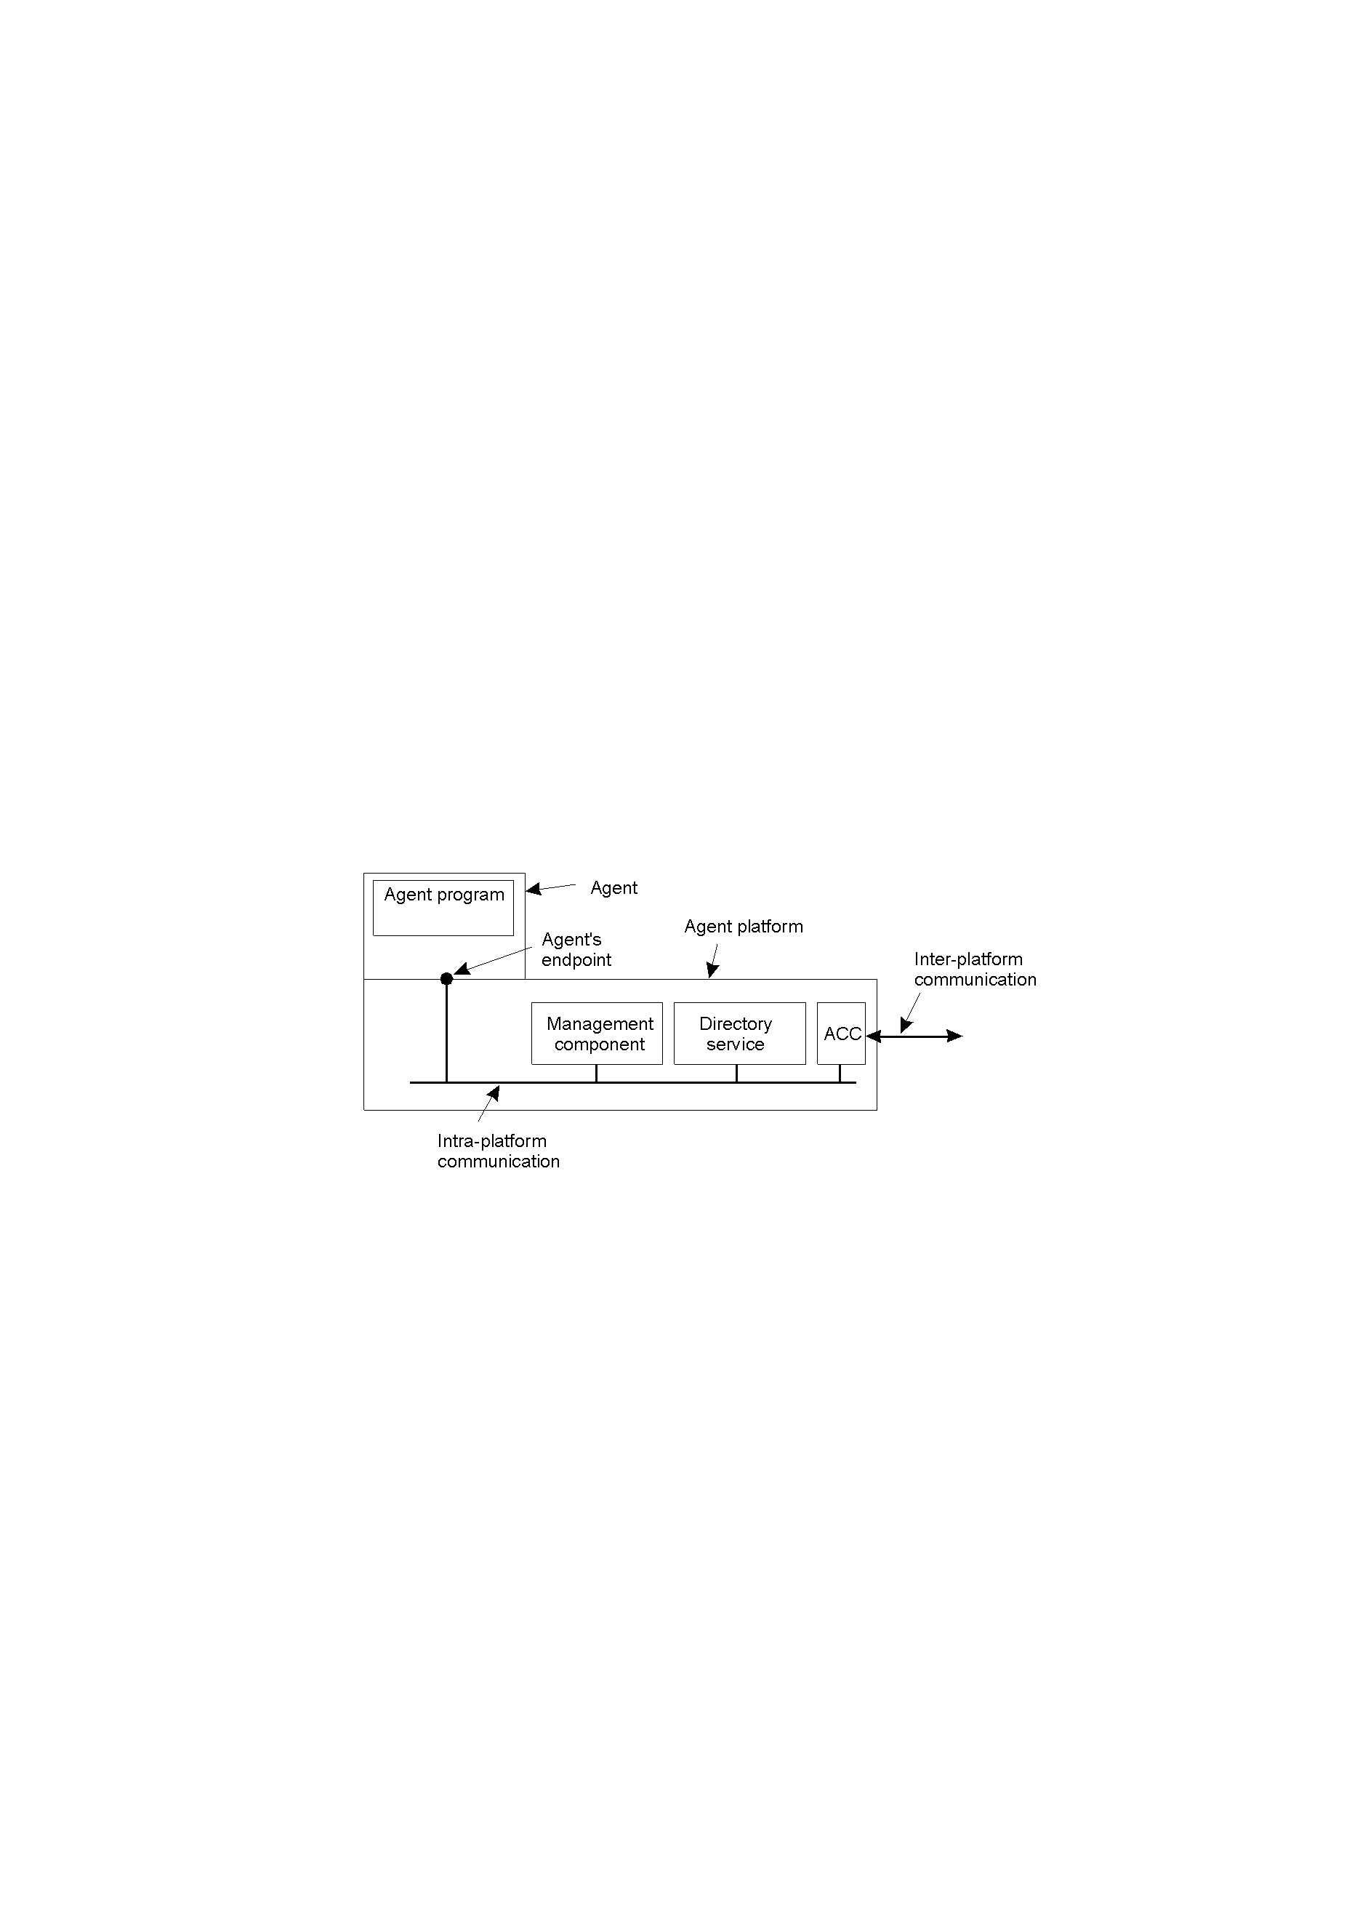
the general model of an agent platform

Slide 62
Agent Communication Languages (ACL)
  ACL: an application-level protocol where communication between agents takes place.
  A message has a purpose and content
  Purpose
    to request a specific service
    to respond to a request
    to inform about an event
    to propose during negotiation

Slide 63
Message purpose | Description | Message Content
INFORM | Inform that a given proposition is true | Proposition
QUERY-IF | Query whether a given proposition is true | Proposition
QUERY-REF | Query for a given object | Expression
CFP | Ask for a proposal | Proposal specifics
PROPOSE | Provide a proposal | Proposal
ACCEPT-PROPOSAL | Tell that a given proposal is accepted | Proposal ID
REJECT-PROPOSAL | Tell that a given proposal is rejected | Proposal ID
REQUEST | Request that an action be performed | Action specification
SUBSCRIBE | Subscribe to an information source | Reference to source
examples of different message types in the FIPA ACL, giving the purpose of a message, along with the description of the actual message content

Slide 64
ACL messages consist of a header and the actual content
The header has different fields:
    a field to identify the purpose of the message,
    fields to identify the sender and the receiver,
    a field to identify the language or encoding scheme for the content (since an ACL does not prescribe the format or language in which the message content is expressed),
    a field to identify a standardized mapping of symbols to their meaning called ontology (if no common understanding of interpreting data)

Slide 65
  e.g., to inform an agent about Dutch royalty relationships
Field | Value
Purpose | INFORM
Sender | max@http://fanclub-beatrix.royalty-spotters.nl:7239
Receiver | elke@iiop://royalty-watcher.uk:5623
Language | Prolog
Ontology | genealogy
Content | female(beatrix), parent(beatrix, juliana, bernhard)
Header
simple example of a FIPA ACL message sent between two agents using Prolog to express genealogy information

Slide 66
The End
Thank You!

